Slide 1
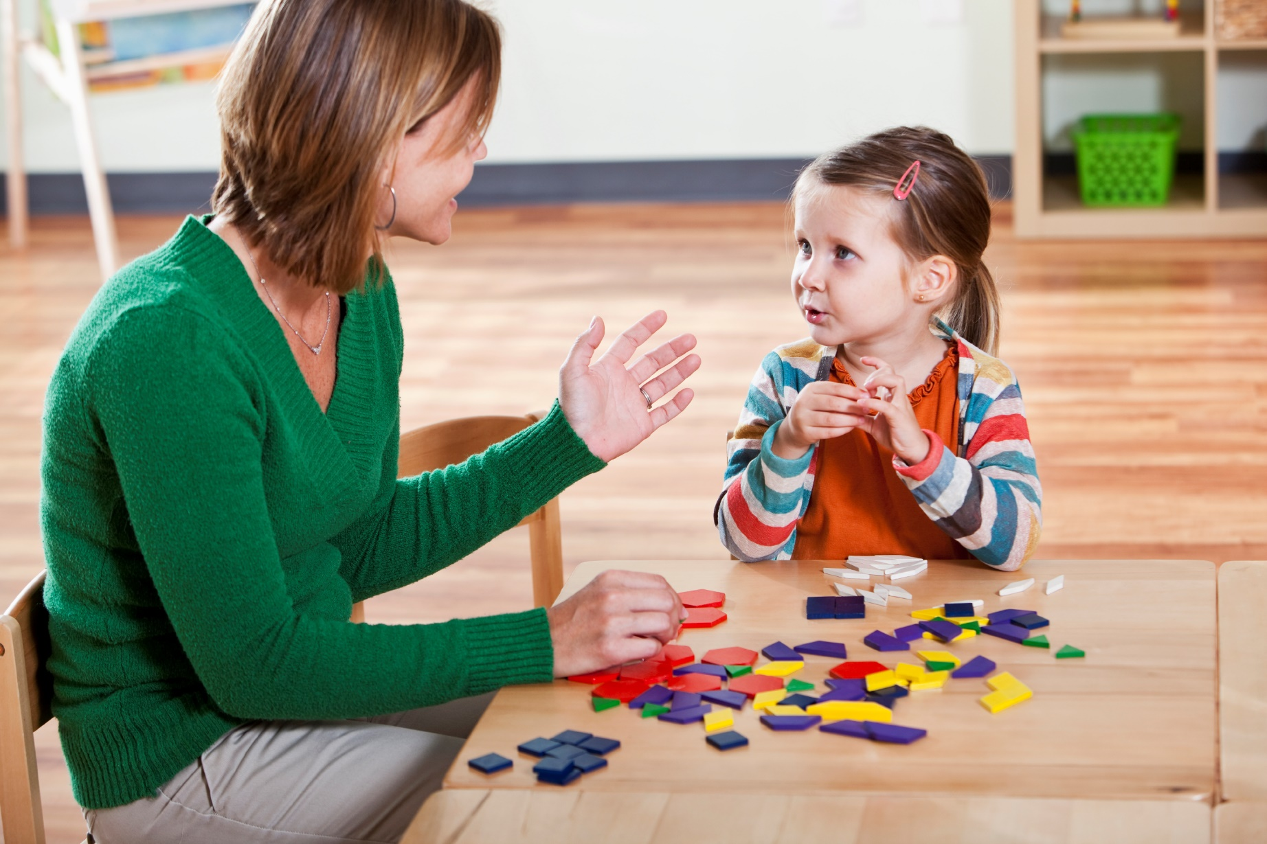
Speech Strategies for Parents

Slide 2
These strategies teach your child how to use communication to get what they want.
Children begin to enjoy the control they have over their world.
Eventually, they express ideas and feelings more successfully.
We will cover ways to support this process at home.

Slide 3
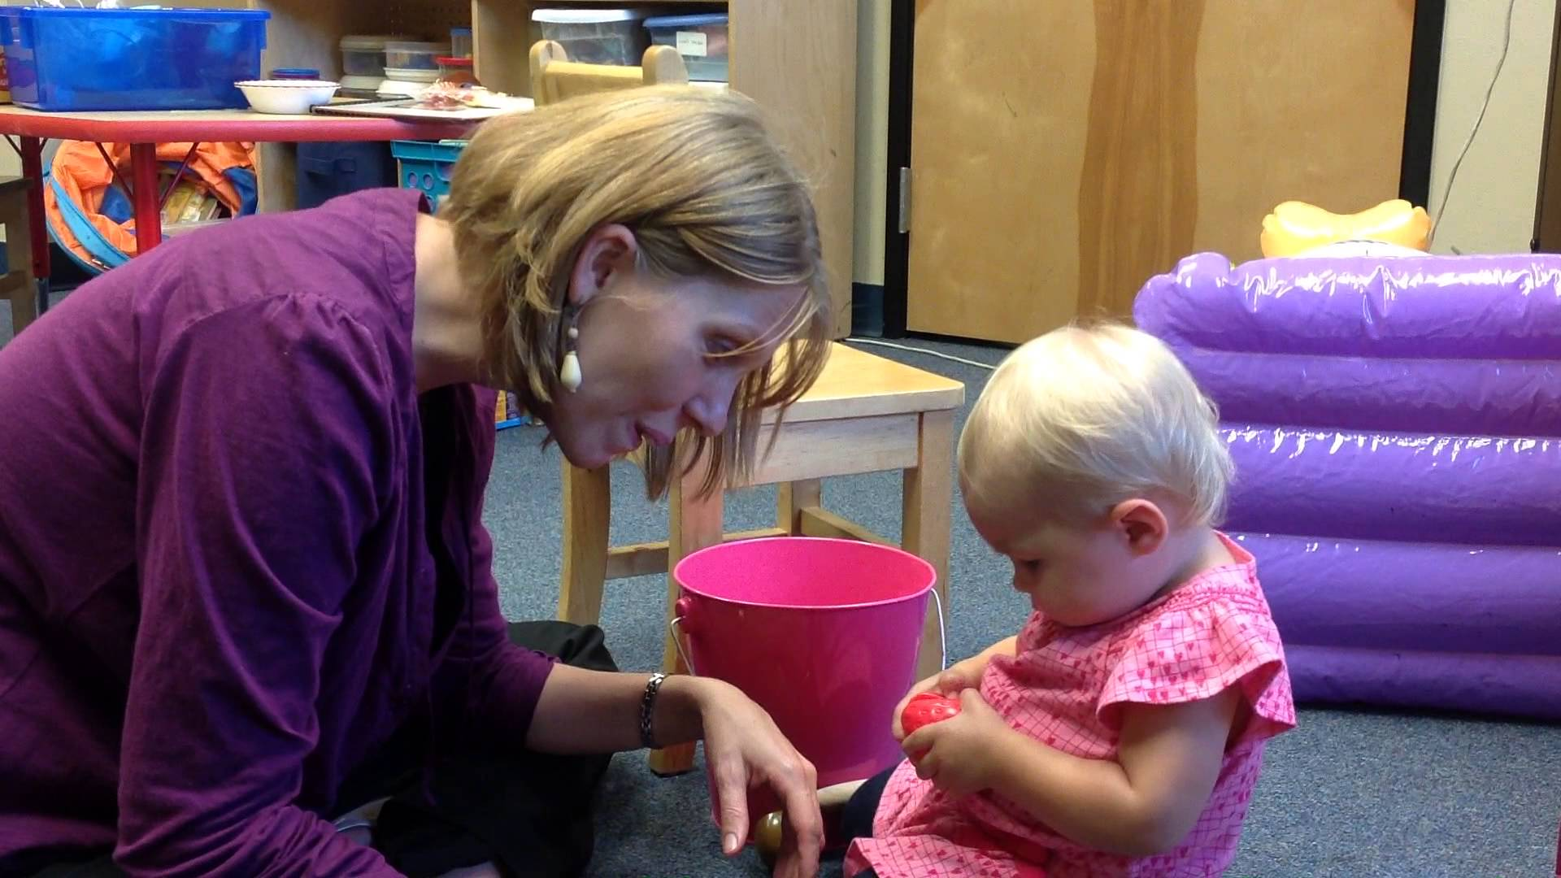
When an adult uses Parallel Talk, she acts as a broadcaster. She watches and describes it to the child, without expecting a response.
Let’s watch a real mom using both!
https://www.youtube.com/watch?v=jSpkmqaMkWs

Slide 4
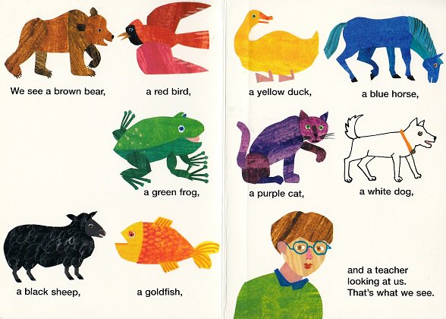
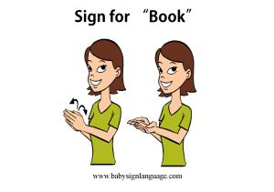
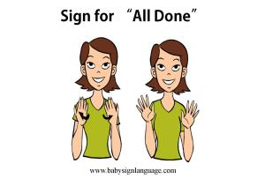

Slide 5
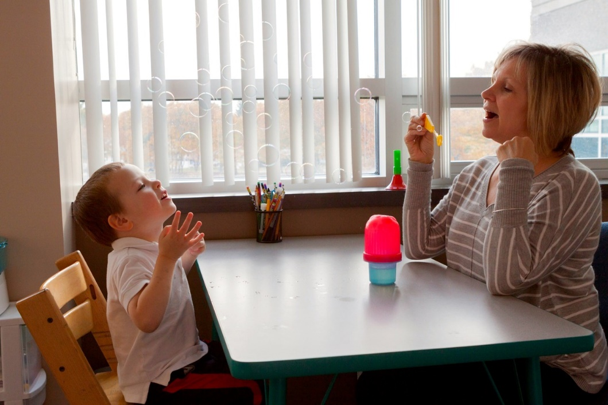
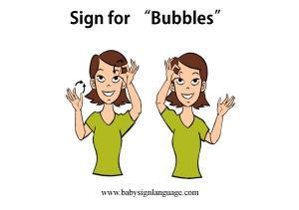
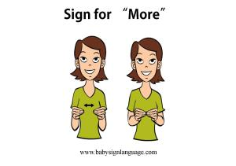
Let’s watch a therapist use this with a student:
https://www.youtube.com/watch?v=XSAxjq_6mQA&t=16s
Bubble clip at 3:50

Slide 6
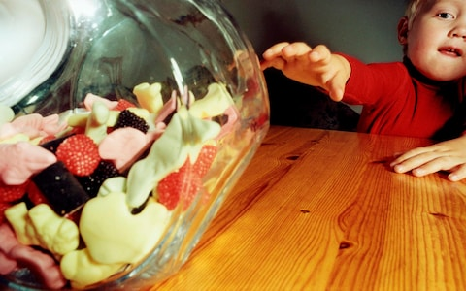
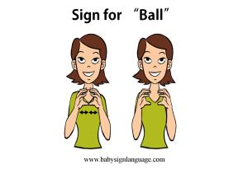
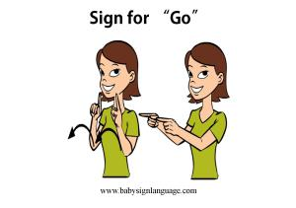
Let’s watch a super cute kid get exactly what he wants:
https://www.youtube.com/watch?v=zXLO2dctux8

Slide 7
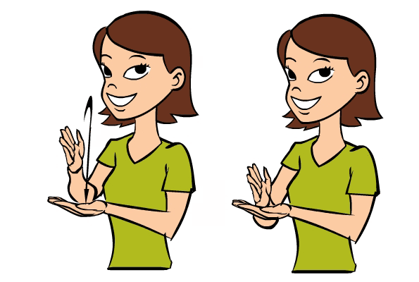
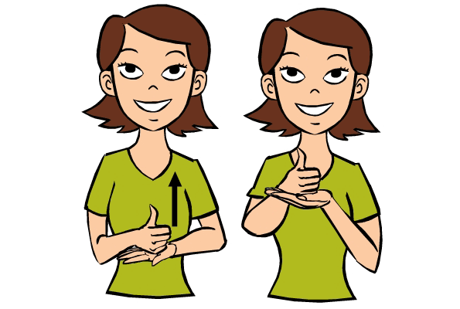
Expanding Language & The +1 Routine
The +1 Routine for suggests that you add just 1 word to your child’s utterance to expose him to language just above his current level.
Repeat what your child says and add 1 word. Your child is not expected to repeat your +1 phrase. It is important to vary the type of words you add. This is a great tool to use when your child has initiated communication. They speak first and you just expand their utterance.
Child: “bird” Parent: “little bird” Child: “me up” Parent: “pick me up”
Child: “help” Parent: “help me”
Sign for “Stop”
Sign for “Help”
Types of Combinations noun + verb (mama go)
action + object (kick ball) action + location (go bed)
Possessor + possession (my ball)

Slide 8
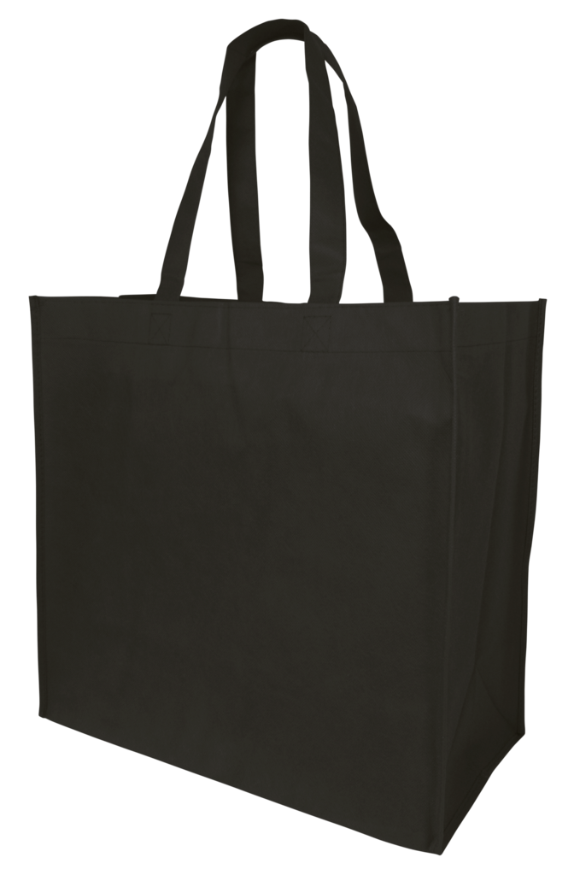
What’s in my bag?

Slide 9
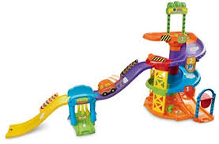
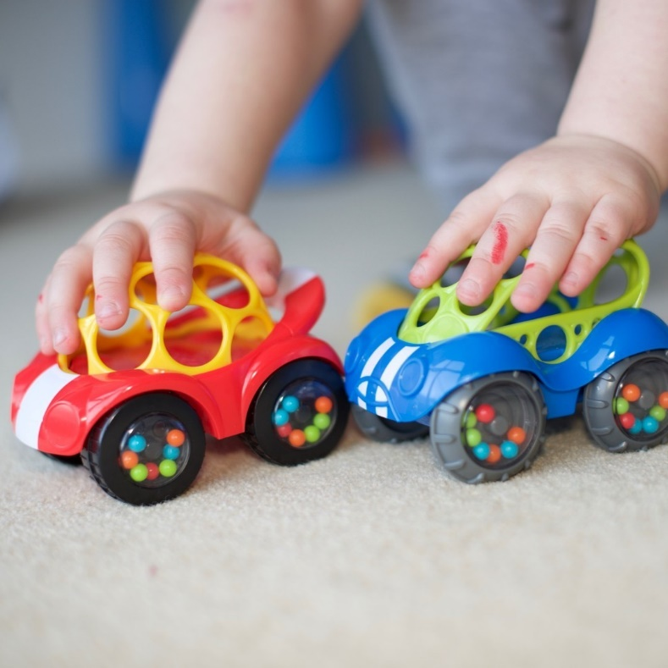
Cars and Tracks
-Develops joint attention and turn-taking skills
-Builds performative words "ready, steady........go", and sounds (vrroom, beep beep)
-Add a bus to this, /b/ is an early sound
-Later on, they can request specific cars

Slide 10
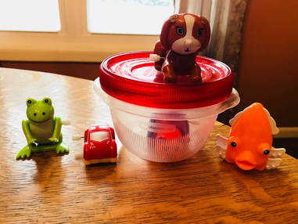
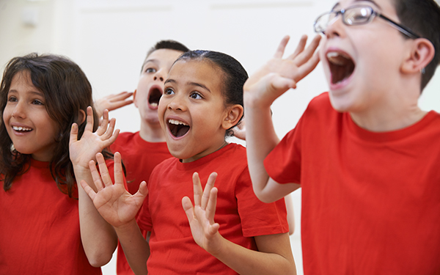
Wind-Up Toys
-Toys that require HELP are great tools!
-A wonderful opportunity to model “go,” “help,” and “open”
-Let child choose the next animal and model the name several times
-Kids love to cheer and comment when these toys RACE!

Slide 11
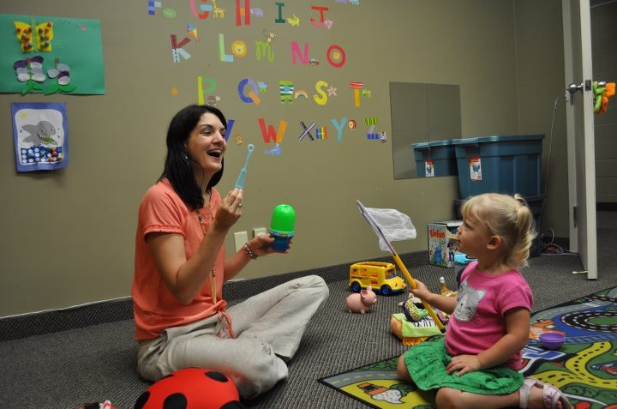
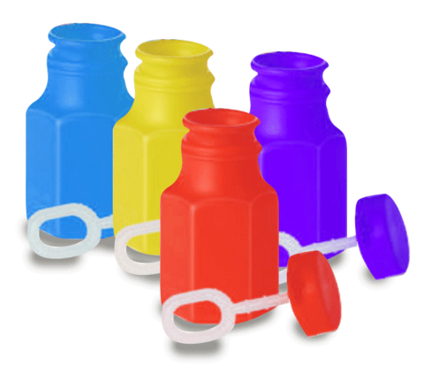
Bubbles
-Perfect motivators for words like, “pop,” “bubble,” “blow,” and “open”
-Close bottle periodically to create opportunities for an “open” request
-Ask if they want the bubbles to go “up” or “down”
- Sing: “There’s a bubble on your nose, on your nose…” modeling different body parts

Slide 12
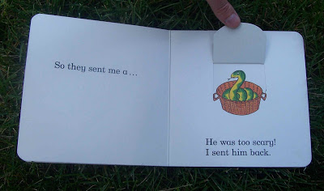
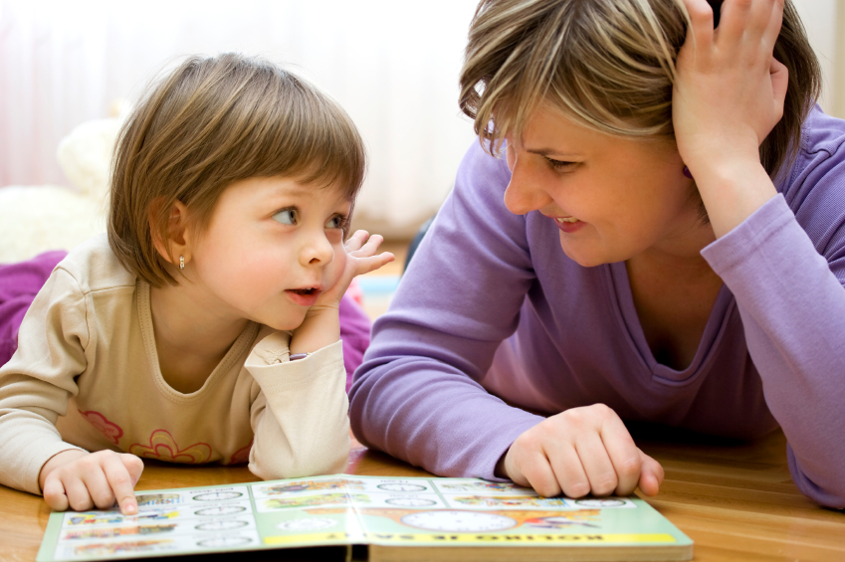
Books
-Flap and noise books are great for “push” and “open”
-Board books are nice and durable for little hands
-Follow your child’s lead as he/she points to pictures
-Make comments such as, “Look at doggy!” (avoid questions)
-Lay on your stomach, facing your child so they can see your face and mouth

Slide 13
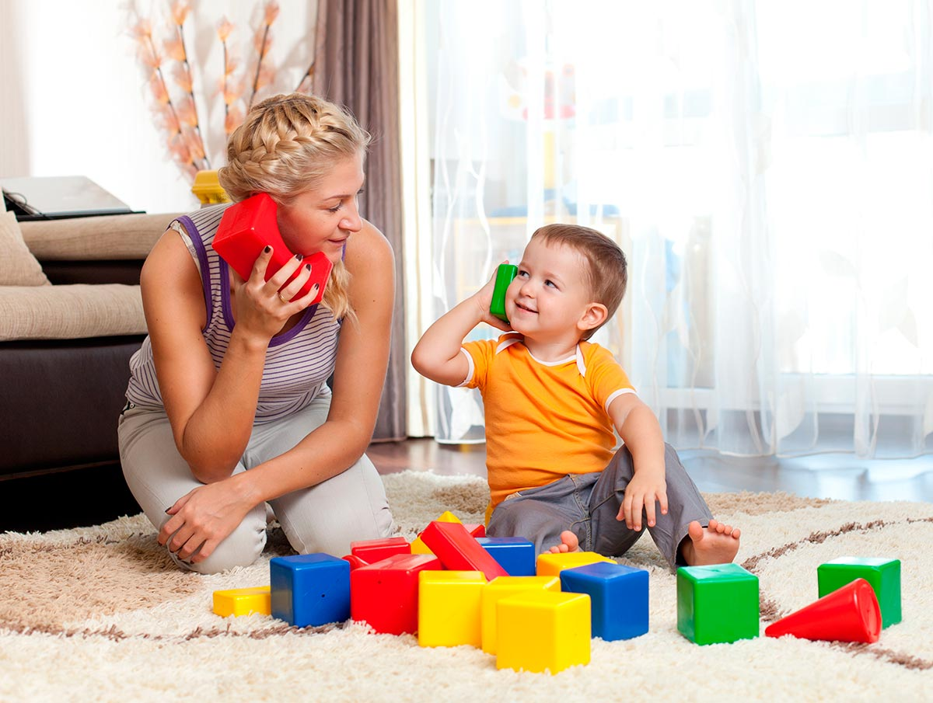
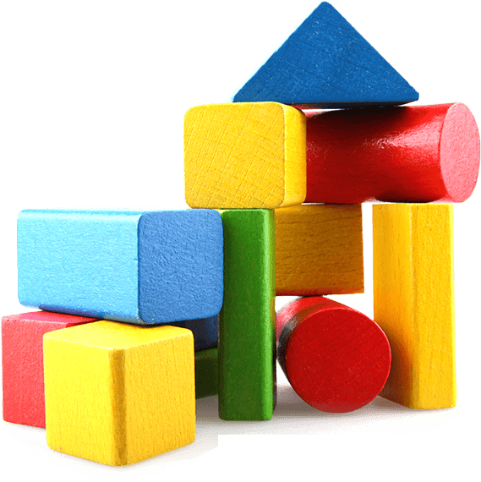
Blocks
-Rainbow blocks let kids choose colors!
-Model color words, then build “up” and knock “down”
-They love when you say, “boom!” or “uh oh!” (great for imitation)
-Build cars and planes, then make them loud! “vroom” “beep beep”
-Blocks are perfect snacks or ice cubes for pretend play

